Slide 1
Go pro
Tanmay Singh Bangari
Nihal Jamal
Course: Master of Computer Applications
Guide
Mrs. Devika Singh
Assistant Professor
Babu Banarasi Das University, Lucknow
Academic Session 2025-2026

Slide 2
introduction
Go Pro is a comprehensive ride-hailing application built in Java, featuring a complete ecosystem for connection riders with drivers. It provides a seamless experience for booking rides, processing payments, tracking locations, and managing user accounts- all with a modern GUI interface

Slide 3
Challenges and proposed Solutions
Though the Go Pro platform considers and demonstrates a comprehensive and wide range of system functionalities, it has several limitations:
• Simulated real-time GPS tracking without connecting to actual maps
• Simulated payment processing using real payment gateways
• Lack of a cloud computing infrastructure platform
• System cannot scale beyond the local machine system
These challenges can be overcome by:
• Web-based rental monitoring system
• Role-based access to the platform

Slide 4
Problem Statement
Manual Booking & billing Process
No Real-time vehicle tracking
Booking conflicts & data errors
Poor fleet monitoring
Limited customer transparency

Slide 5
Objectives
To automate rental vehicle operations
Real- time vehicle availability
Centralized management system
Generate rental & revenue reports
Secure role-based authentication
Improve operational efficiency

Slide 6
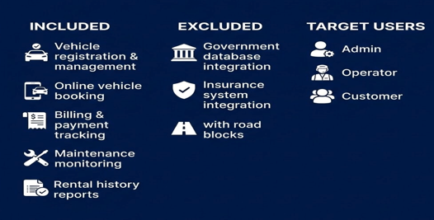
Scope of project

Slide 7
Proposed system
Full-stack web application
MVC architecture implementation
Automated booking & billing
Role-based dashboards
Secure authentication system
Real –time monitoring

Slide 8
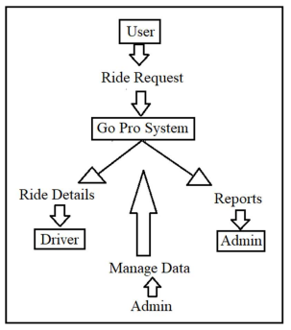
Dfd level 0

Slide 9
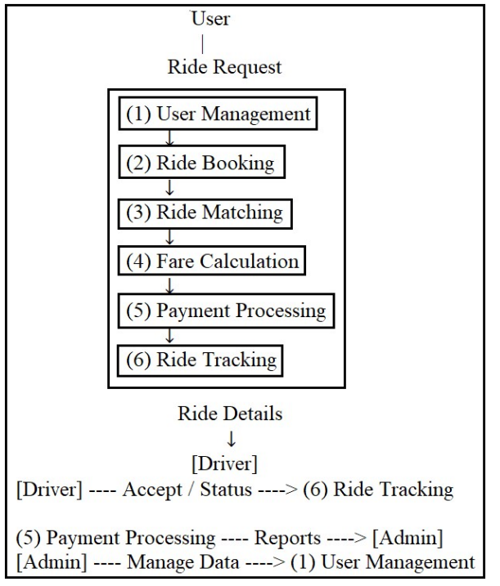
Dfd level 1

Slide 10
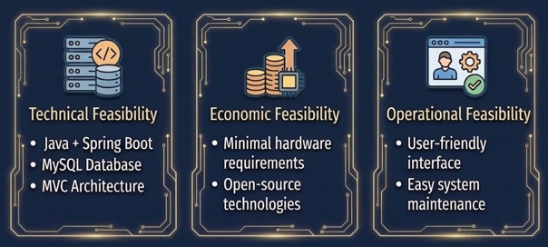
Feasibility study

Slide 11
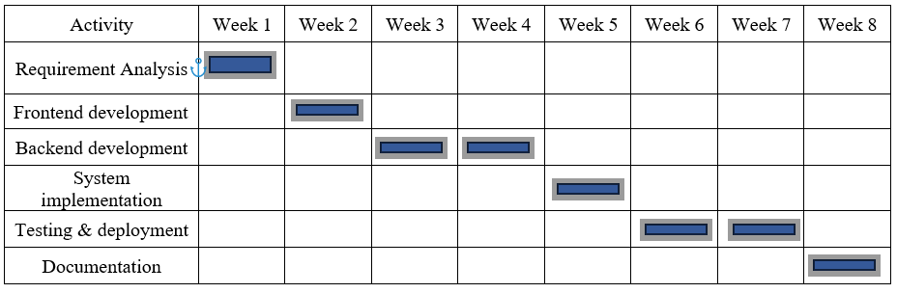
Gantt chart

Slide 12
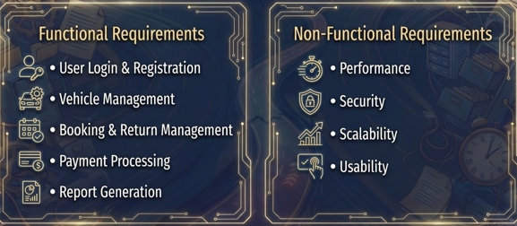
Requirement analysis

Slide 13
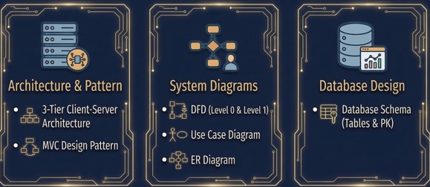
System design

Slide 14
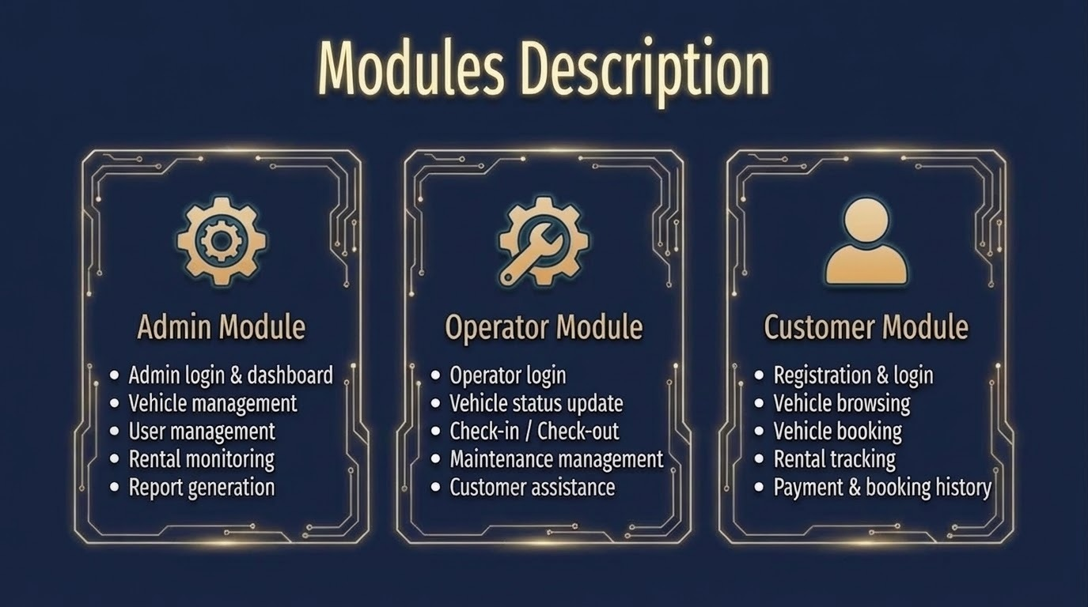

Slide 15
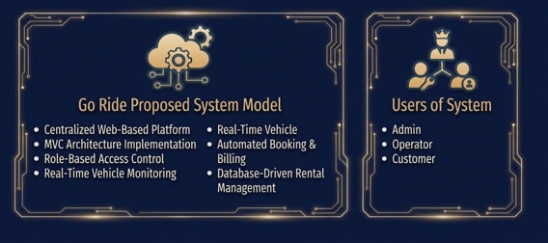
Proposed model

Slide 16
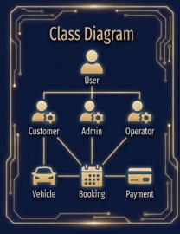
Class diagram

Slide 17
Technology stack
Java: Core Language
Swing: GUI Framework
Collections: Data Structures Management
LocalDateTime: Date/ Time Handling

Slide 18
conclusion
A functional ride-hailing system has been developed
• Real-time ride booking and driver matching have been implemented
• Dynamic fare calculation has been successfully integrated
• Payment processing and wallet system are operational
• Safety features such as SOS emergency have been included
• The system follows a modular and scalable architecture

Slide 19
Thank You

